Slide 1
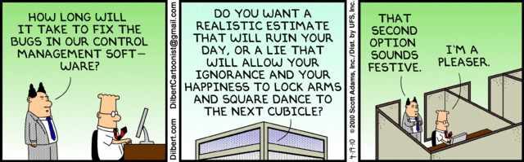
Midterm Review
CIS 422/522
Stuart Faulk

Slide 2
Next
Midterm Wednesday
  Multiple choice, short answer
  Based on lectures
  Review lecture on line: pwd CIS422online
Project II
  Put up project ideas to share
  Short discussions with instructor for initial selection

Slide 3
The “Software Crisis”
Have been in “crisis” since the advent of big software (roughly 1965)
What we want for software development
  Low risk, predictability
  Lower costs and proportionate costs
  Faster turnaround
What we have:
  High risk, high failure rate
  Poor delivered quality
  Unpredictable schedule, cost, effort
  Examples: Ariane 5, Therac 25, Mars Lander, DFW Airport, FAA ATC, Cover Oregon
Characterized by lack of control

Slide 4
Large System Context
Discuss issues in terms of large, complex systems
  Multi-person: many developers, many stakeholders
  Multi-version: intentional and unintentional evolution
Quantitatively distinct from small developments
  Complexity of software rises exponentially with size
  Complexity of communication rises exponentially
Qualitatively distinct from small developments
  Multi-person introduces need for organizational functions, policies, oversight, etc.
  More stakeholders and more kinds of stakeholders
We can only approximate this in our projects
Notes:
Large systems with their accompanying need for large numbers of people involved lead to increasing stratification, specialization, and rigidity. There arise many barriers to communication, maneuverability that do not exist for small developments.

Slide 5
Implications: the Large System Difference
Small system development is driven by technical issues (I.e., programming)
Large system development is dominated by organizational issues
  Managing complexity, communication, coordination, etc.
  Projects fail when these issues are inadequately addressed
Lesson #1: programming ≠ software engineering
  Techniques that work for small systems often fail utterly when scaled up
  Programming alone won’t get you through real developments or even this course
Notes:
Software engineering is about everything but programming
This is why we have spent so much time on this.

Slide 6
View of SE in this Course
The purpose of Software Engineering is to gain and maintain intellectual and managerial control over the products and processes of software development.
  Intellectual control: able to make rational development decisions based on an understanding of the downstream effects of those choices.
  Managerial control means we likewise control development resources (budget, schedule, personnel).
Notes:
Key idea: to gain and maintain control over the factors affected by architecture, need sound practice (effective and predictable)
Intellectual control: i.e., we know what we are doing and why.

Slide 7
Course Approach
Learn methods for acquiring and maintaining control of software projects (two threads)
Managerial control
  Team organization and people management
  Organizing people and tasks
  Planning and guiding development
Intellectual control
  Establishing and communicating exactly what should be built
  Making effective decisions about system properties (behavioral and developmental)
  Choosing appropriate order for decisions and ensuring feedback/correction
Notes:
Important to understand the problem

Slide 8
The Software Lifecycle

Slide 9
Need to Organize the Work
Nature of a software project
  Software development produces a set of interlocking, interdependent work products
    E.g. Requirements -> Design -> Code
  Implies dependencies between tasks
  Implies dependencies between people
Must organize the work such that:
  Every task gets done
  Tasks get done in the right order
  Tasks are done by the right people
  The product has the desired qualities
  The end product is produced on time

Slide 10
Usefulness of Life Cycle Models
Application of “divide-and-conquer” to software processes and products
  Identify distinct process objectives
  Can then address each somewhat separately
Intended use
  Provide guidance to developers in what to produce and when to produce it
  Provide a basis for planning and assessing development progress
Never an accurate representation of what really goes on

Slide 11
A “Waterfall” Model
Requirements
Analysis
As a guide: does not address
some common development risks
  What happens if requirements
  are wrong?
  Is scheduling or budget is wrong?
Architecture
Design
Coding
System Integration
and Testing
Problems of temporal
distance
As a model: unrealistic as a
model of any real development
Useful in identifying conceptually
distinct activities
Deployment
Maintenance and
Evolution
Notes:
This is illustrated in the Waterfall model. Activities are distinct in purpose but necessarily interdependent.

Slide 12
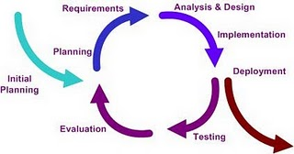
Characteristic Processes:
The Iterative Model
Process is viewed as a sequence of iterations
  Essentially, a series of waterfalls
Addresses some common waterfall risks
  Risk that software cannot be completed – build incremental subsets
  Risk of building the wrong system – stakeholder have opportunities to see the software each increment
  Also, can double check feasibility, schedule, budget and others issues
Notes:
Iterative models were described in the 1970s by Basili & Turner and by Parnas, among others. Unwrap a spiral model and what you find is an iterative model. Not very clear what the difference is. Agile methods “took over” the idea of iterative models and use them heavily, generally with rather short iterations, say 2-4 weeks.

Slide 13
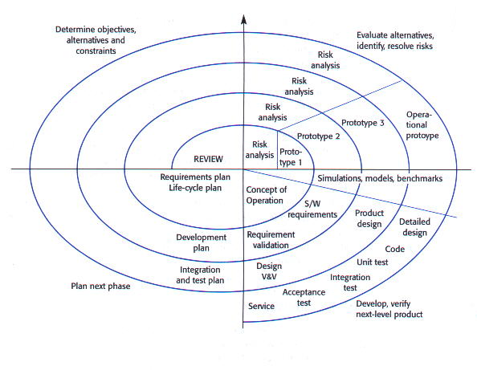
Characteristic Processes:
The Spiral Model
Process viewed as repeating cycles of increasing scale
Identify risks and determine (next set of) requirements
Each cycle builds next version by extension, increasing scale each time
Explicit Go/No-Go decision points in process
Notes:
Barry Boehm created the spiral model at least partly to illustrate the role of risks and mitigating risks in the software development process. As risks are resolved, spirals produce larger versions of the system

Slide 14
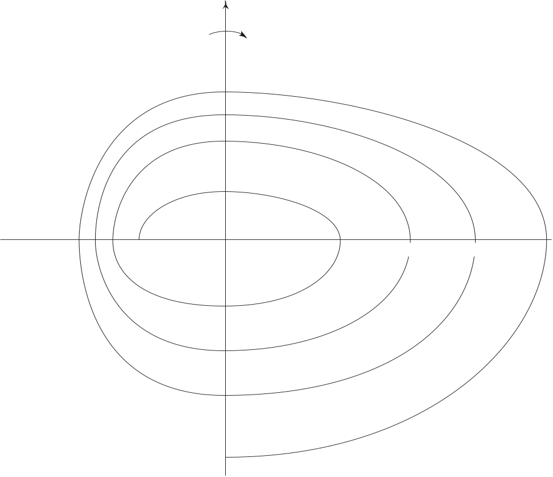
Spiral Model
determine
goals
Risk evaluation
and Mitigation
plan next
phase
development

Slide 15
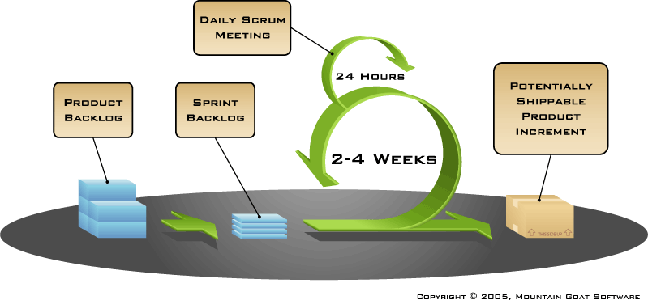
Characteristic Processes:
Agile (e.g. scrum)
Process viewed as nested sequence of builds (sprints)
  Each build adds very small feature set (one or two)
  Nightly build/test, frequent customer validation
  Focus on delivering code, little or no time spent on documentation

Slide 16
Process Objectives
Objective: proceed in a controlled manner from stakeholder needs to a design that demonstrably meets those needs, within design and resource constraints
  Understand that any process description is an abstraction
  Always must compensate for deviation from the ideal
  Still important to have a well-defined process to follow and measure against
Choose process to provide an appropriate level of control for the given product and context
  Sufficient control to achieve results, address risks
  No more than necessary to contain cost and effort
Question of control vs. cost: processes introduce overhead

Slide 17
Example
Project 1 requirements and constraints
  Deadline and resources (time, personnel) are fixed
  Delivered functionality and quality can vary (though they affect the grade)
  Risks:
    Missing the deadline
    Technology problems
    Inadequate requirements
    Learning while doing
Process model
  All of these risks can be addressed to some extent by building some version of the product, then improving on it as time allows (software and docs.)
  Technology risk requires building/finding software and trying it (prototyping)
  Most forms of incremental development will address these

Slide 18
Project Planning and Management

Slide 19
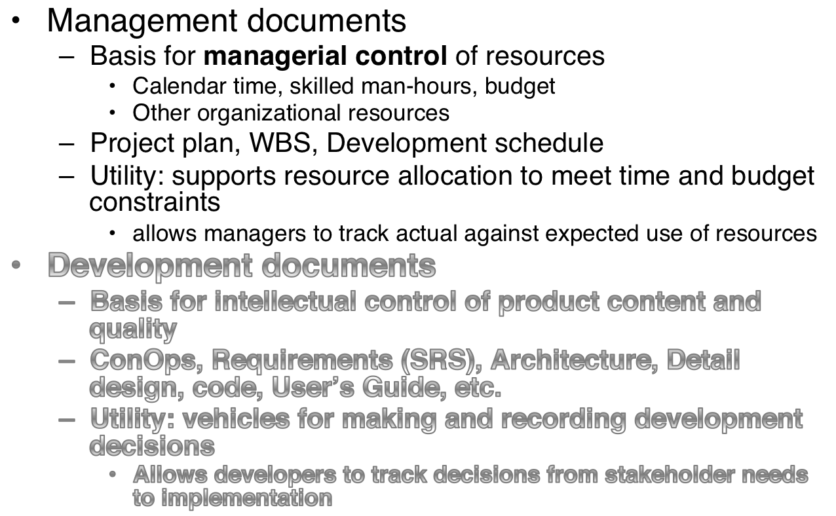
Document Types and Purposes

Slide 20
Project Plan
Purpose: specifies how project resources will be organized to:
  Create each deliverable
  Meet quality goals
  Address developmental goals (e.g., mitigate risk)
Audience: should answer specific kinds of questions for different types of users, e.g.:
  Customers: When will the product be delivered?
  Stakeholders: What is the development approach? How does it address project risks?
  Managers: When will tasks be completed? What is the current progress against the plan?
  Developers: What should I be working on and when?

Slide 21
From Process to Plan
Process manifests itself in the project plan
  Process definition is an abstraction
  Many possible ways of implementing the same process
Project plan makes process concrete, it assigns
  People to roles
  Artifacts to deliverables and milestones
  Activities to tasks over time
Evolves as the project proceeds

Slide 22
Planning Tools
Work Breakdown Structure: decompose tasks and allocate responsibilities
  If incomplete, some tasks may not be done
  If imprecise, people do not know exactly what to do
  Without a complete set of tasks, schedules are unrealistic
PERT charts: identify where ordering of tasks may cause problems
  Represent precedence or resource constraints
  Identify critical path
Gantt Charts: method for visualizing project schedule (tasks, dependencies, timing, persons)
Note that these help address problems our projects have encountered

Slide 23
Intellectual Control

Slide 24
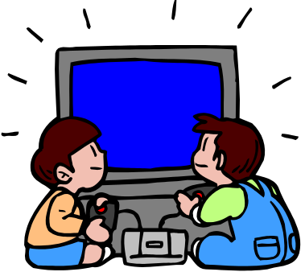
Product Development Cycle
Business Goals
Hardware
Software
Marketing
Product Planning
Development &
Marketing Strategy
Stakeholder goals
Requirements
Functionality
Qualities
Design
Goals/
tradeoffs
Code
Intellectual control: delivery of
Functional capabilities
Software qualities
Test &
Validate
Deploy
Notes:
This picture illustrates the correspondence between phases of the development process and the products produced. In particular, it shows the two kinds of requirements specifications, one owned by the business side (the BRD, MRD, or ConOps) and one owned by the technical side (the Software Requirements Specification). We will discuss the purpose and content of each of these in the following weeks.
Note, however, that these indicate distinct kinds of information. Not all organizations actually develop distinct documents.

Slide 25
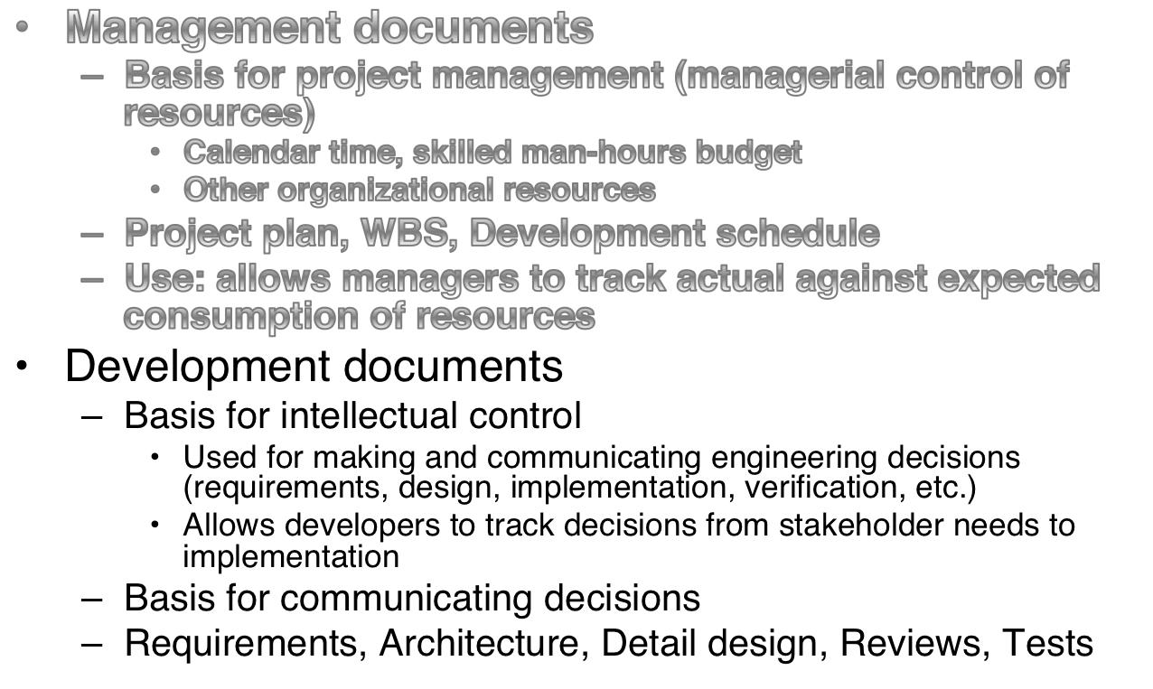
Document Types and Purposes

Slide 26
What is a “software requirement?”
A description of something the software must do or property it must have
The set of system requirements denote the problem to be solved and any constraints on the solution
  Specifies “what” not “how”
  Bounds the set of acceptable implementations

Slide 27










Importance of Getting Requirements Right
1. The majority of software errors
are introduced early in software
development
2. The later that software errors are
detected, the more costly they are
to correct
100
50
$100 error
50
40
$1 error
20
30
10
20
5
10
2
0
requirements
construction and
acceptance
1
and
design
system
testing and
requirements
design
code
unit test,
acceptance initial
functional
development test
operation
debug
integration
test
operation
analysis
Development Phase
Phase in which error detected
Notes:
Student Questions: Why do we observe the phenomena depicted in the graphs?
For 1: Follows from waterfall model. The real checking of requirements doesn't start until developers try to use them to produce designs and code. Most verification and validation is actually delayed until system integration and test (when the behavior of the running code can be observed).
For 2: A multiplication of effects. Requirements tend to "fan out" (i.e., one requirements -> multiple design items -> even more code). Errors also have to be "rolled back" in the sense that all the products up-stream in the development cycle have to be re-worked, re-verified, etc. when an error is detected.

Slide 28
Requirements Phase Goals
What does “getting the requirements right” mean in the systems development context?
Only three goals
  Understand precisely what is required of the software
  Communicate that understanding to all of the parties involved in the development (stakeholders)
  Control production to ensure the final system satisfies the requirements
Sounds easy but hard to do in practice, observed this and the resulting problems in projects
Understanding what makes these goals difficult helps us understand how to mitigate the risks

Slide 29
What makes requirements difficult?
Comprehension (understanding)
  People don’t (really) know what they want (…until they see it)
  Superficial grasp is insufficient to build correct software
Communication
  People work best with regular structures, coherence, and visualization
  Software’s conceptual structures are complex, arbitrary, and difficult to visualize
Control (predictability, manageability)
  Difficult to predict which requirements will be hard to meet
  Requirements change all the time
  Together make planning unreliable, cost and schedule unpredictable
Inseparable Concerns
  Many requirements issues cannot be cleanly separated
  Difficult to apply “divide and conquer,” must make tradeoffs
Implication: all the requirements goals are difficult to achieve, must be managed as a risks!
Notes:
“Divide and conquer” works best with clean separations, if changes to one imply changes to the other, cannot effectively separate them.

Slide 30
Requirements Communication
(Specification)
Many potential stakeholders using requirements for different purposes
  Customers: the requirements document what should be delivered
  Managers: provides a basis for scheduling and a yardstick for measuring progress
  Software Designers: provides the “design-to” specification
  Coders: defines the range of acceptable implementations
  Quality Assurance: basis for validation, test planning, and verification
  Also: potentially Marketing, regulatory agencies, etc.

Slide 31



Needs of Different Audiences
Customer/User
  Focus on problem understanding
  Use language of problem domain
  Technical if problem space is technical
Problem Understanding/
Business Needs
Customer
Requirements
Analyst
Development organization
  Focus on system/software solutions
  Use language of solution space (software)
  Precise and detailed enough to write code, test cases, etc.
Detailed technical
Requirements
Developer

Slide 32
Documentation Approaches
ConOps: informal requirements to describe the system’s capabilities from the customer/user point of view
  Answer the questions, “What is the system for?” and “How will the user use it?”
  Tells a story: “What does this system do for me?”
  Helps to use a standard template
SRS: formal, technical requirements for development team
  Purpose is to answer specific technical questions about the requirements quickly and precisely
  Precise, unambiguous, complete, and consistent as practical

Slide 33
Scenario Analysis and Use Cases
Common user-centered analysis method
Requirements Elicitation
  Identify stakeholders who interact with the system
  Collect “user stories” - how people would interact with the system to perform specific tasks
Requirements Specification
  Record as use-cases with standard format
  Use templates to standardize, drive elicitation
Requirements verification and validation
  Review use-cases for consistency, completeness, user acceptance
  Apply to support prototyping
  Verify against code (e.g., use-case based testing)

Slide 34
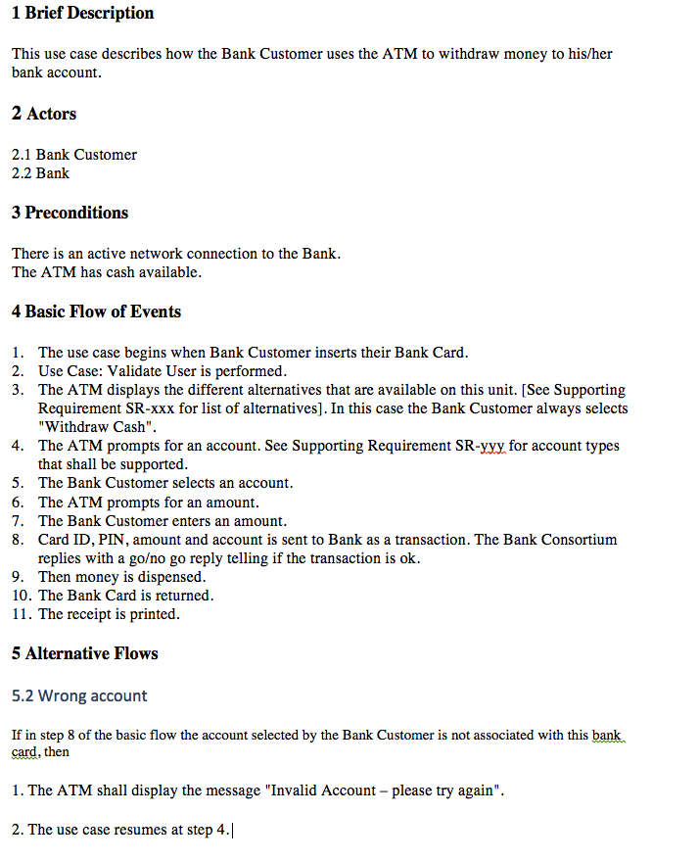
Example Use Case
Avoids design decisions
References other use cases
References more precise definitions where necessary
Some terms need further definition (e.g. PIN)

Slide 35
Benefits and Drawbacks
Use cases can be an effective tool for:
  Eliciting user-group’s functional requirements
  Communicating to non-technical stakeholders
  Creating initial test cases
  Verifying expected behavior
Generally inadequate for detailed technical requirements
  Difficult to find specific requirements
  Inherently ambiguous and imprecise
  Cannot establish completeness or consistency
True of all informal specification methods

Slide 36
Technical Specification
The SRS
The role of rigorous specification

Slide 37
Requirements Documentation
Is a detailed requirements specification necessary?
How do we know what “correct” means?
  How do we decide exactly what capabilities the modules should provide?
  How do we know which test cases to write and how to interpret the results?
  How do we know when we are done implementing?
  How do we know if we’ve built what the customer asked for (may be distinct from “want” or “need”)?
  Etc…
Correctness is a relation between a spec and an implementation (M. Young)
  Implication: until you have a spec, you have no standard for “correctness”

Slide 38
Technical Requirements
Focus on developing a technical specification
  Should be straight-forward to determine acceptable inputs and outputs
  Can systematically check completeness consistency
Provides
  Detailed specification of precisely what to build
  Design-to specification
  Build-to specification for coders
  Characterizes expected outputs for testers
Little application in Project 1

Slide 39
Quality Requirements

Slide 40
Quality Requirement Types
Avoid “functional” and non-functional" classification
Behavioral Requirements – any requirements or constraints on the system's run-time behavior
  Measurable qualities (safety, performance, fault-tolerance)
  In theory all can be validated by observing the running system and measuring the results
Developmental Quality Attributes - any constraints on the system's static construction
  Maintainability, reusability, ease of change (mutability)
  Measures of these qualities are necessarily relativistic (I.e., in comparison to something else
Notes:
Behavioral requirements: constitute a black box specification of required behavior.
“In theory” is a euphemism for “not really” – for many of these qualities, we do not have sufficiently rigorous metrics or tools (e.g., fault tolerance) to either define the requirement or to understand it it has been met. Analogous to “productivity” in programming.
Relativistic – e.g., design A is easier to change than design B for the set of expected changes
“functional” typically defines the set of acceptable mappings form inputs to outputs. “non-functional” is everything else.

Slide 41
Behavioral and Developmental
Requirements
Behavioral (observable)
Performance
Security
Availability
Reliability
Usability
Properties resulting from the behavior of components, connectors and interfaces that exist at run time.
Developmental Qualities
Modifiability(ease of change)
Portability
Reusability
Ease of integration
Understandability
Support concurrent development
Properties resulting from the structure of components, connectors and interfaces that exist at design time whether or not they have any distinct run-time manifestation.

Slide 42
Importance
Quality requirements are as or more important to user acceptance than functional
  Every system has critical quality requirements
  The most frequent reason for user dissatisfaction
Quality requirements are often implicit or assumed
  E.g., response time, data integrity
Must be explicit to be controlled
  Implicit requirements cannot be communicated, tracked, verified, etc.
  Left out at crunch time

Slide 43
Specifying Quality Requirements
When using natural language, write objectively verifiable requirements when possible
  Load handling: The system will support a minimum of 15 concurrent users while staying with required performance bounds.
  Maintainability: “The following kinds of requirement changes will require changes in no more than one module of the system…”
  Performance:
    “System output X has a deadline of 5 ms from the input event.”
    “System output Y must be updated at a frequency of no less than 20 ms.”

Slide 44
Requirements Validation and Verification
Feedback-control for requirements
Should answer two distinct questions:
  Validation: “Are we building to the right requirements?”
  Verification: “Are we building what we specified?”
Validation requires going back to the stakeholders: can use many techniques
  Review of specifications
  Prototyping, software review
  Use case walkthroughs
Verification requires checking work products against specifications
  Review
  Testing
  Formal modeling and analysis

Slide 45
Real meaning of “control”
What does “control” really mean?
Can we really get everything under control then run on autopilot?
Rather control requires continuous feedback loop
  Define ideal
  Make a step
  Evaluate deviation from idea
  Correct direction or redefine ideal and
  go back to 2

Slide 46
End

Slide 47
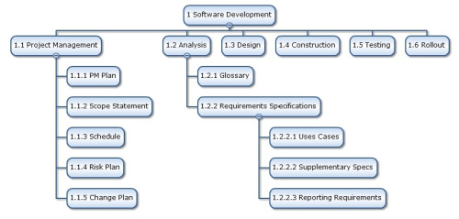
Work Breakdown Structure
Software Development
  Project Management
  Analysis
    Glossary
    Requirements Specification
      Use Cases
      Supplementary Specs…
Equivalent list format

Slide 48
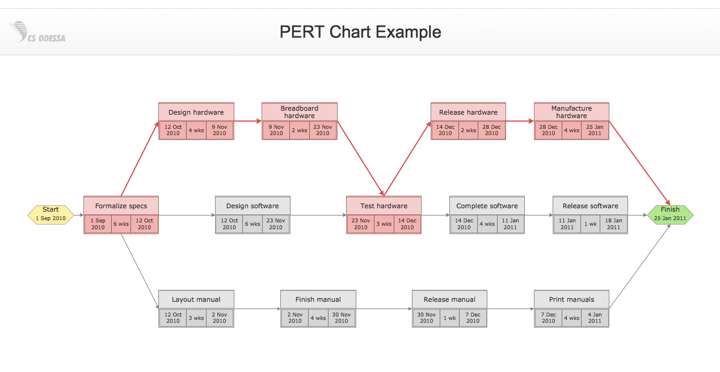
Which tasks can we start on?
Which tasks can be done concurrently?
Which tasks depend on which other tasks?
Critical Path: which path has the longest duration?
  Gives minimum length of project
http://www.conceptdraw.com/samples/project-chart

Slide 49
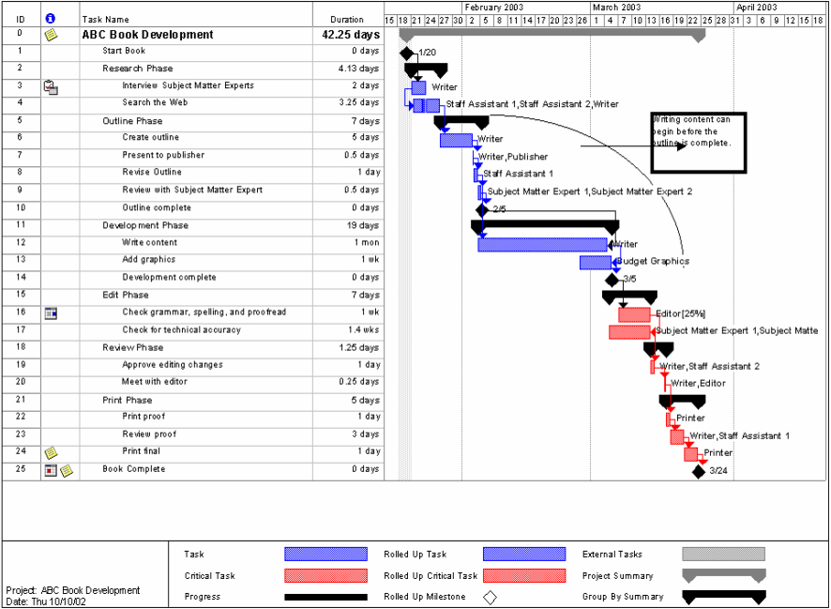
Example Gantt Chart

Slide 50
Teamwork and
Group Dynamics

Slide 51
What do software developers do?
Most time is not spent coding
So how do they spend their time?
IBM study (McCue, 1978):
  50% team interactions
  30% working alone (coding & related)
  20% not directly productive
-Technical excellence is not enough
Must understand how to work effectively in teams

Slide 52
Being a Good Team Member
Attributes most valued by other team members
  Dependability
    When you say you’ll do something, you do it
    Correctly
    On time
  Carrying your own weight (doing a fair share of the work)
People will overlook almost everything else if you do these

Slide 53
Consensus decision making
Consensus is not counting votes
  Democracy is 51% agreement
  Unanimity is 100% agreement
Consensus is neither
  Everyone has their say
  Everyone accepts the decision, even if they
  don't prefer it
  It is "buying in" by group as a whole, including those who disagree
Usually best approach for peer groups
Consensus takes time and work, but is worthwhile
Notes:
Product of negotiation. Goal is to find an acceptable solution. Usually no one gets everything they want.

